Slide 1

Capital Area Food Bank
Final Project Report
DataDigestion

Slide 2




Meet the Team!
Sapna Bagalkotkar
Computer Science
Aaron Kurtz
Finance
Ben Lin
Computer Science
Natalie Wolfe
Mechanical Engineering
DataDigestion

Slide 3






Roadmap
Tasks
Tools and Methods
Next Steps
Opportunity
Data Sources & Plan
Results

Slide 4
Opportunity

Slide 5

Meet the Client!
380,000
individuals across the DMV continuously served
Goal is to break the cycle of poverty for these individuals
Point of Contact: Jake Erlich
Opportunity
Tasks
Data Sources
Tools and Methods
Results
Next Steps
Notes:
380,000 constituents served

Slide 6
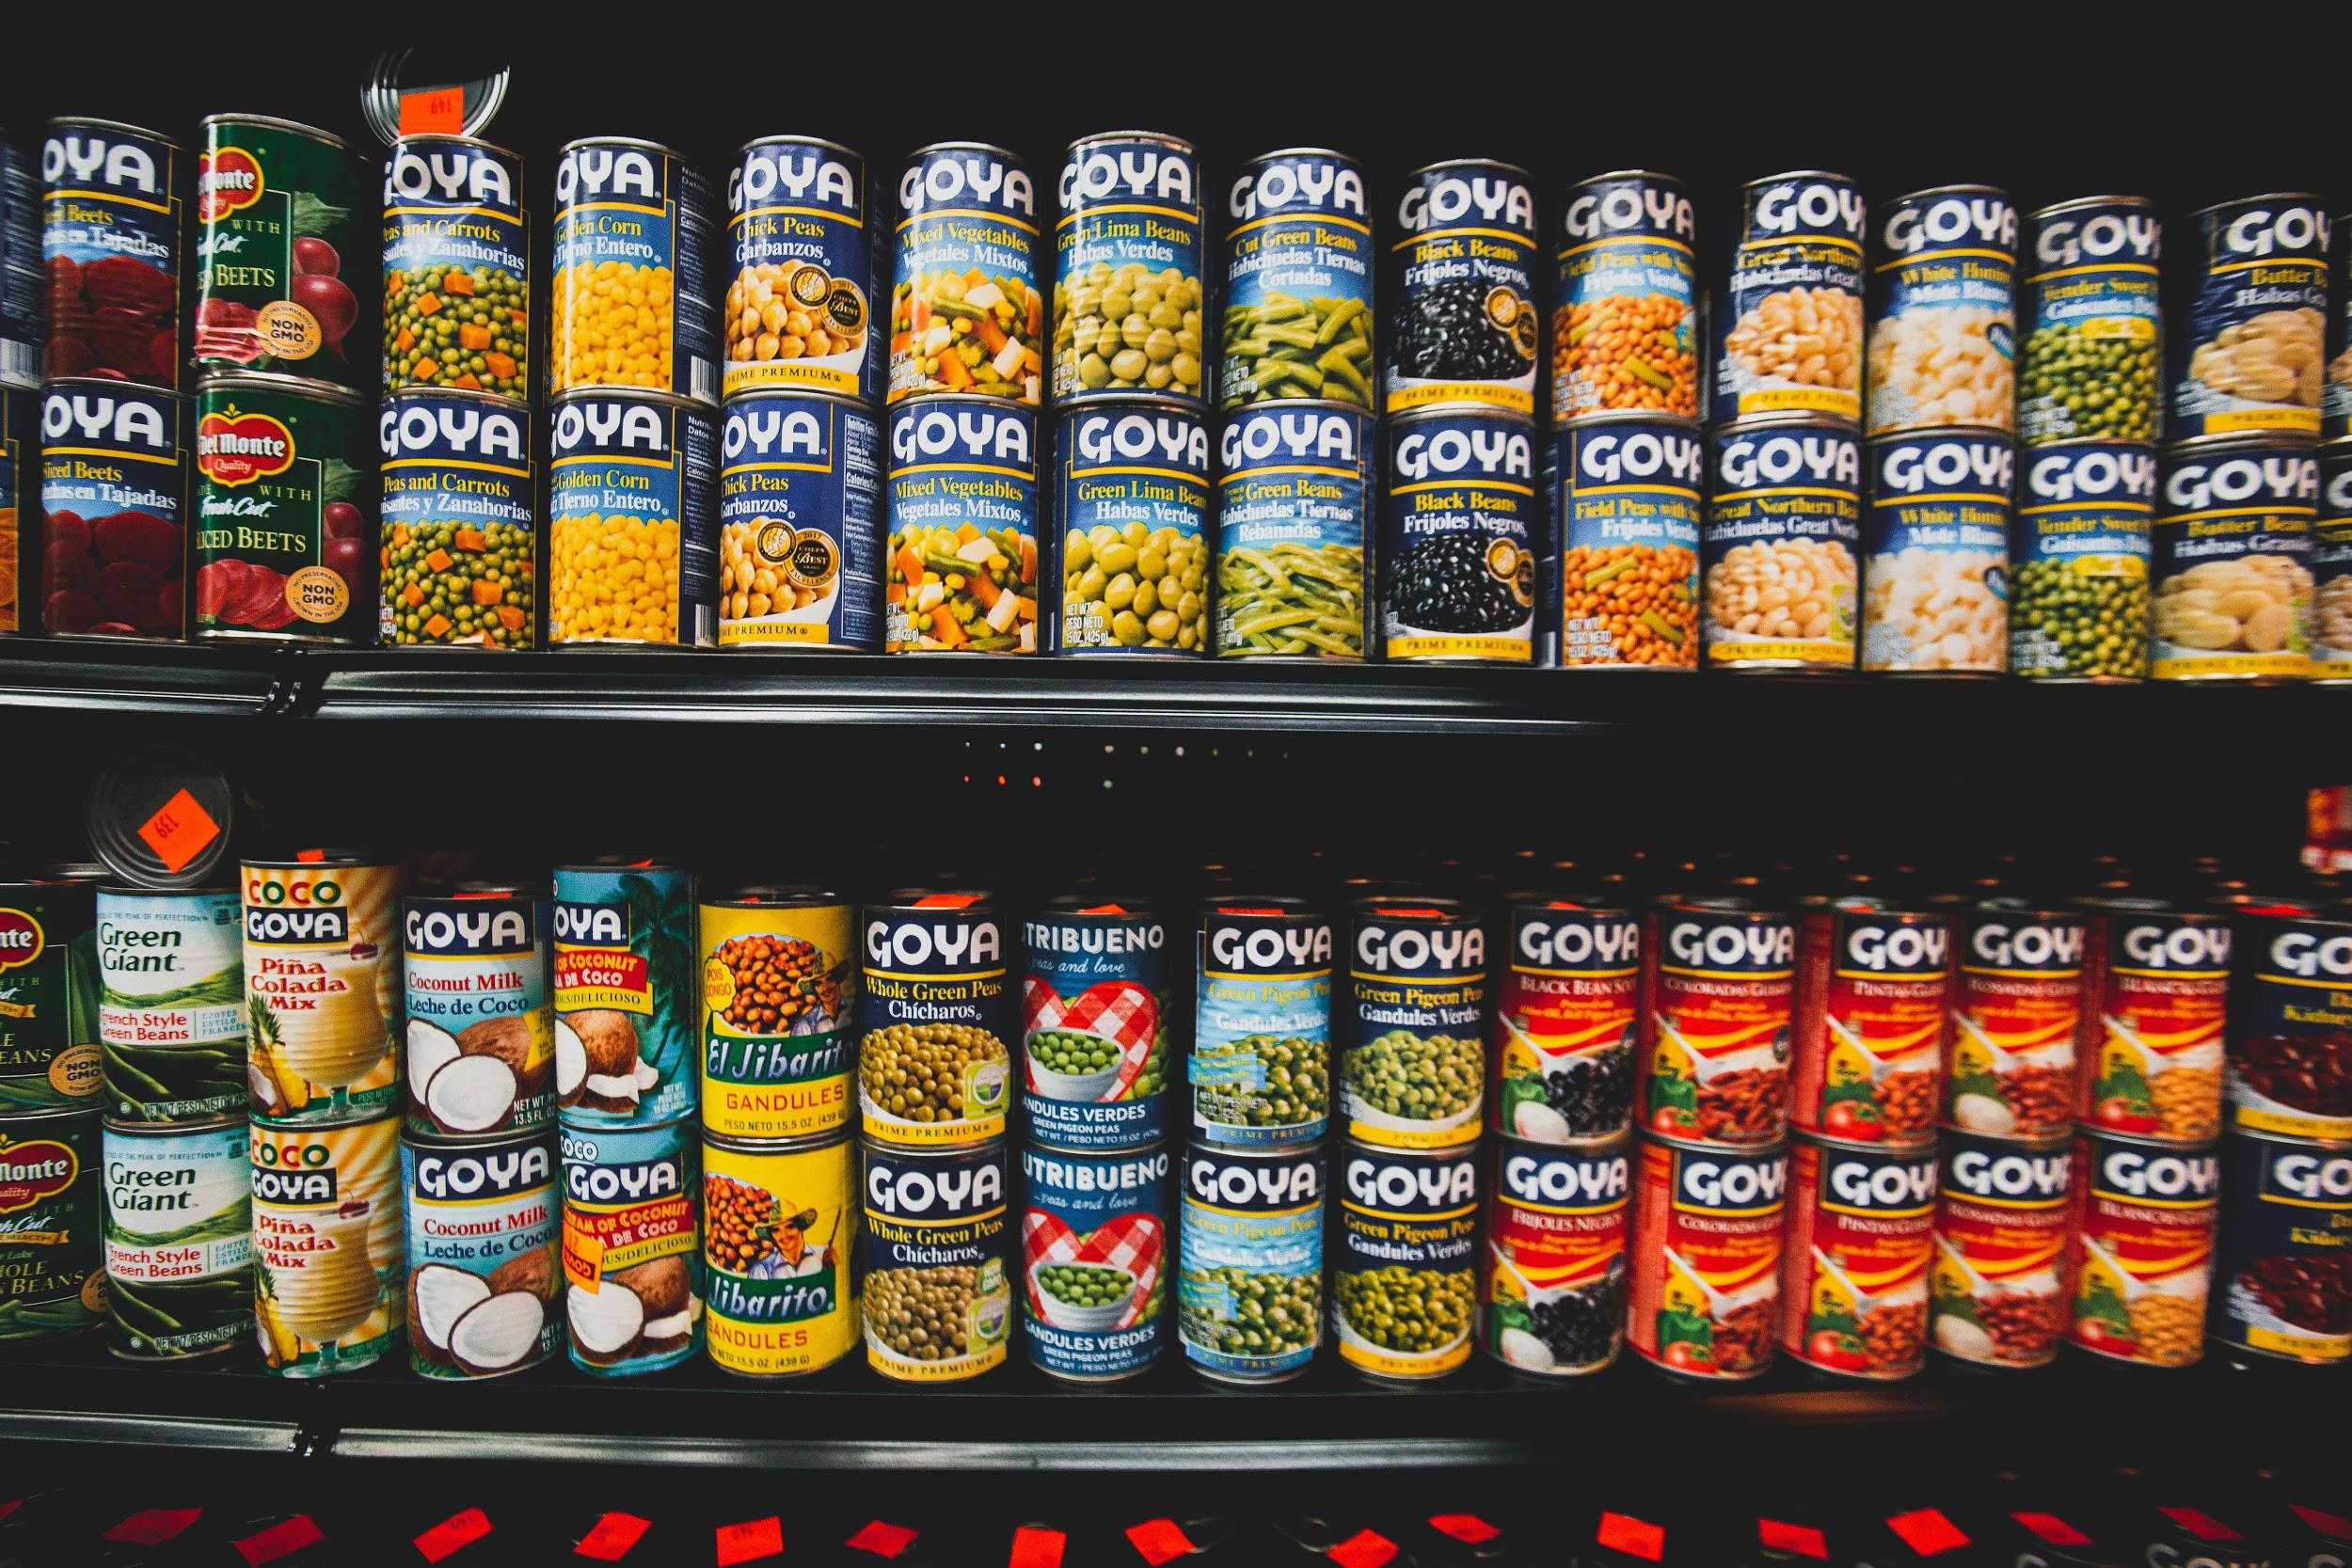
Problem
CAFB wants to optimize their impact in the most opportunistic neighborhoods.

Slide 7
Tasks

Slide 8
Tasks
Original Tasking
New Tasking
Predict density shifts in food insecurity
Find opportunities for CAFB expansion in Federal Opportunity Zones
Expand CAFB partnerships with healthcare organizations
Identify areas with the greatest opportunity for improvement in the DMV area
Recommend census tracts that are in the greatest need of CAFB resources
Opportunity
Tasks
Data Sources
Tools and Methods
Results
Next Steps
Notes:
Opportunity zone - an economically distressed community private investments, under certain conditions, may be eligible for capital gain tax incentives.
by incentivizing long- term investments in low-income neighborhoods.

Slide 9
Data Sources & Plan

Slide 10
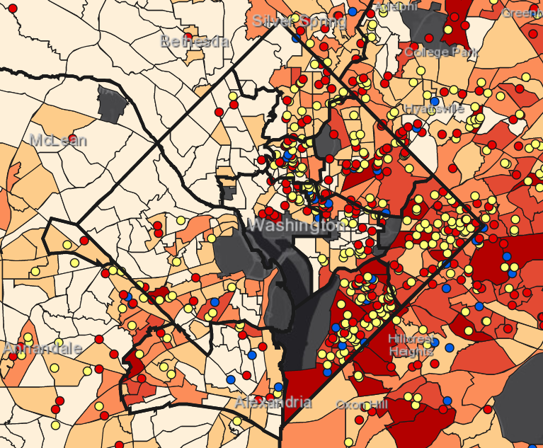
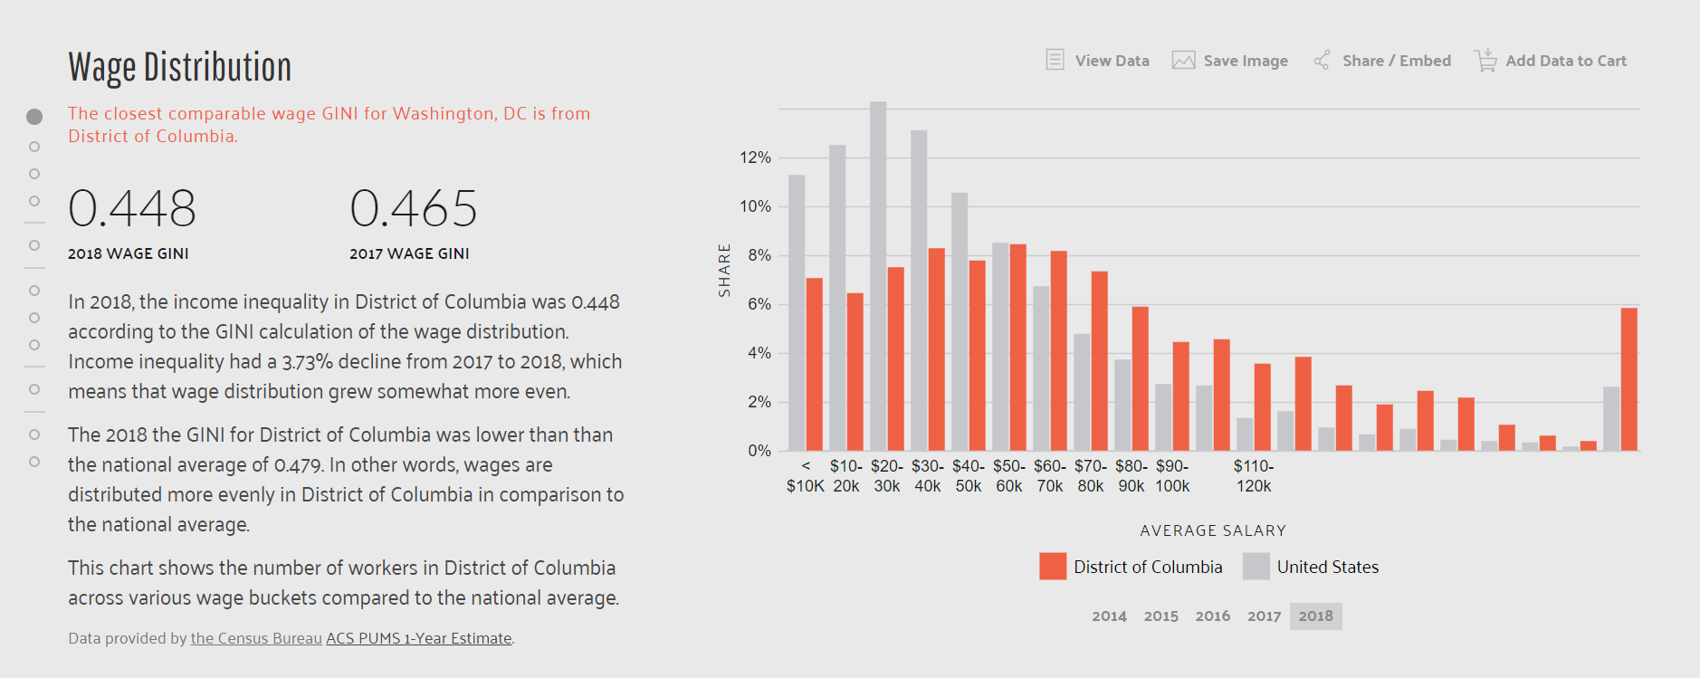
Data Sources
The census data we have right now is the recently released (in January) 2013-2018 ACS data. Pulled from here.
https://data.census.gov/cedsci/
https://datausa.io/profile/geo/washington-dc/
https://healthdata.gov/
Hunger Heat Map
ArcGIS software
Two CSV files
CAFB Distribution Locations
Census Socioeconomic Data
https://healthdata.gov/
Opportunity
Tasks
Data Sources
Tools and Methods
Results
Next Steps
Notes:
Thanks natalie. The main data source we were given to work with is something unique to the CAFB as opposed to other foodbanks worldwide, and it is what they call their hunger heat map. This file is a large csv that hold geolocation data where various layers represent columns data accumulated for the DMV area. The layers tell us information such as food insecure population numbers, percentages, number of partners , and various census socioeconomic data points for each census tract in the DMV area. The map can be run live on an arcGIS web platform and is consistently updated.

Slide 11
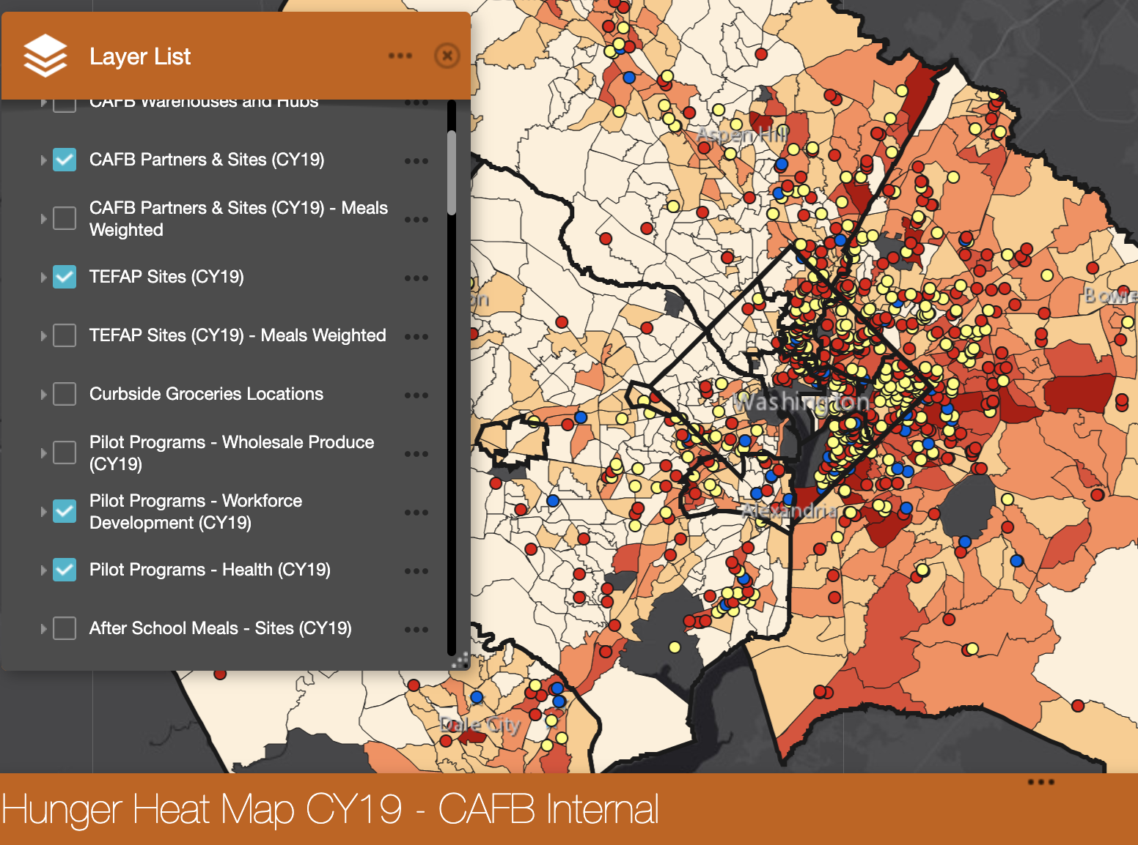
Data Plan: Graphical Representation
Representation of which census tracts require more service from the CAFB
HHM overlays, folium maps with new possible locations plotted on overlay
Opportunity
Tasks
Data Sources
Tools and Methods
Results
Next Steps
Notes:
Given this data, we first intended on looking at time sensitive data to track the migration of food insecure populations. However, given only one set of this data ad a specific point in time, we decided instead to train a model to predict the partner count of CAFB resources per census tract based on layers of the map such as food insecure population, health insurance percentage, and public transport reliance among others. By making this model and running it on the data set, we planned to analyze outliers that would indicate where the number of resources based on these other variables was not matching up, where negative residuals would indicate where CAFB could potentially use more resources, given the data of the independent variables chosen.

Slide 12
Tools and Methods

Slide 13






Tools Used
Data Analysis
Data Visualization
Opportunity
Tasks
Data Sources
Tools and Methods
Results
Next Steps
Notes:
Through the use of many tools including pandas and statsmodels.api we were able to create a linear regression model in order to find out in which specific census tracts CAFB resources could be used more effectively. We then used a combination of arcGIS and Folium, a geolocation visualization package through python to analyze residuals and be able to view our results on an interactive map. By creating a model, we could analyze outliers to see where the partner count did not align with the other independent variables that represent a need for CAFB resources in each specific census tract.
Next, Ben will go into more details about our models results and the analysis of the residuals we found.

Slide 14
Results

Slide 15
HHM Data
HHM data is split into census tracts, which each have descriptive data.
Predictor Variables
2019 Food Insecure Rate
2019 Food Insecure Population
Public Transport Percent
Poverty Percent
Health Insurance Percent
Non English Percent
Median Income
Percentage High School Educated
Target Variable
Number of CAFB Locations within a Census Tract
Opportunity
Tasks
Data Sources
Tools and Methods
Results
Next Steps
Notes:
As Sapna mentioned earlier, using our dataset, we manually identified several independent variables that we believed were likely to be strongly correlated to our target which is the number of CAFB locations within a census tract. The independent variables as listed on the left.

Slide 16
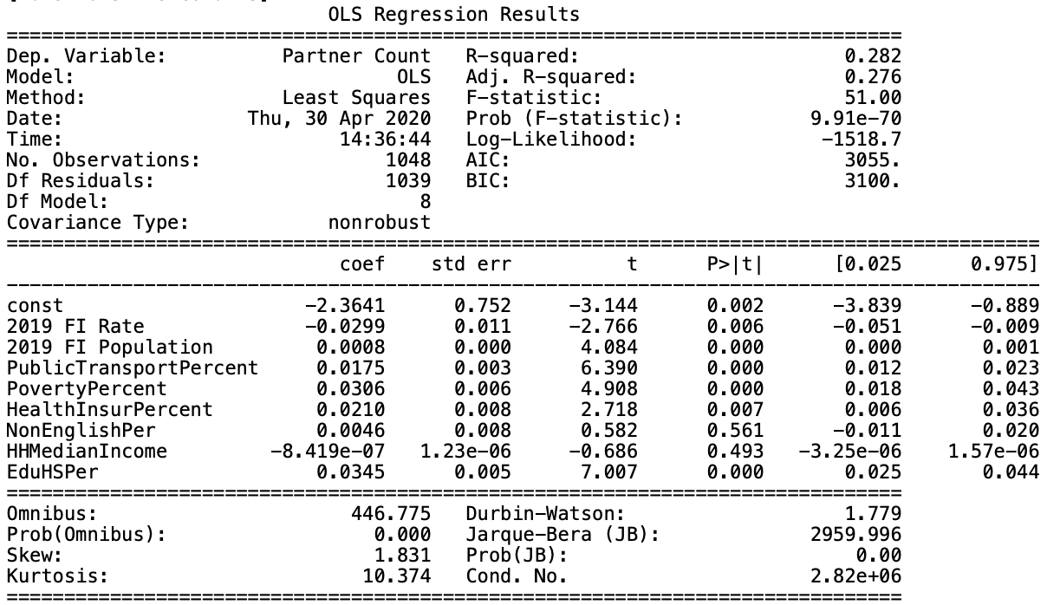
OLS Regression
Variables outlined in orange significantly impact if there is a CAFB distribution center in the census tract.
Opportunity
Tasks
Data Sources
Tools and Methods
Results
Next Steps
Notes:
Looking at the results from the OLS regression, we noticed several of the predictors that were used were significant at the 5% level, as highlighted in orange. This includes the Food insecure Rate, as well as the poverty percentage, health insured percentage, and high school educated percentage.

Slide 17
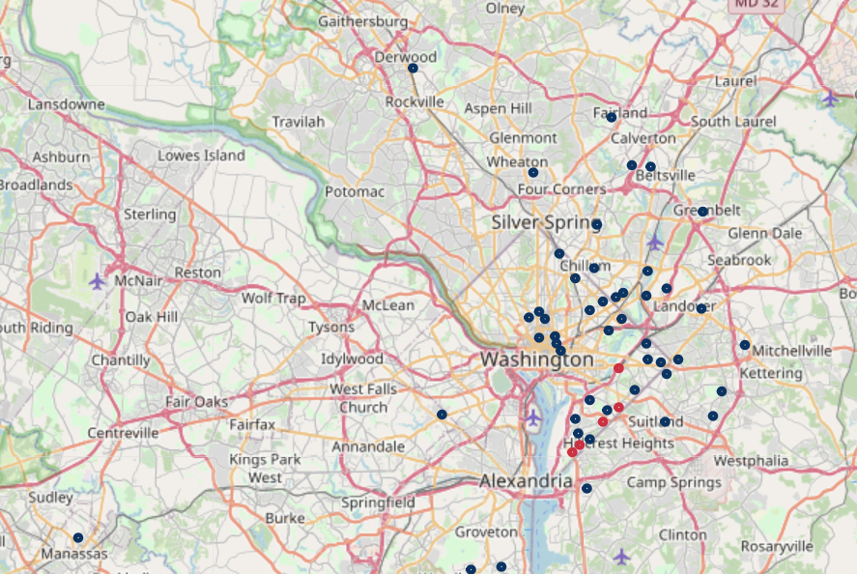
Graphical Representation of Results
5
census tracts with significant negative residual values indicate areas where CAFB resources are needed
50
census tracts with significant positive residual values indicate areas where CAFB resources can be reallocated
Opportunity
Tasks
Data Sources
Tools and Methods
Results
Next Steps
Notes:
And looking at the residuals from our model, we were able to identify 5 census tracts that had the most significant negative residual, meaning there is a extremely low number of partners relative to other tracts, given the statistics of the area -- most of which only contain 0 or 1 CAFB partners. These are areas where we believe are potentially areas of greatest opportunity for the CAFB to further step in.
We also noticed 50 census tracts with significant positive residual values. Areas that have an abnormally high number of CAFB partners where resources may be better reallocated away from. However, some of these positive residuals can be explained due to the different natures of CAFB partners. An example of this would be health care providers.

Slide 18
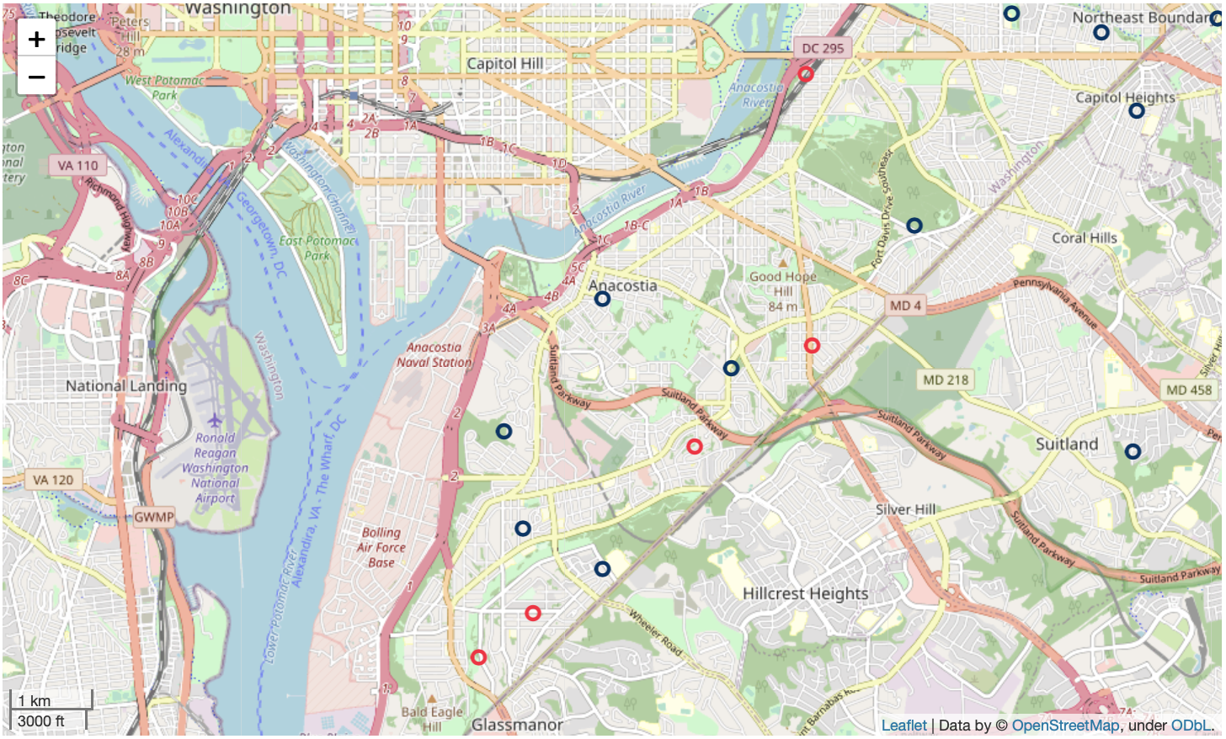
Graphical Representation of Results
5
census tracts with significant negative residual values indicate areas where CAFB resources are needed
Census Tract 98.01
FI Rate: 39.1%
FI Population: 1081
Public Transport: 44.6%
Partner Count: 0
50
census tracts with significant positive residual values indicate areas where CAFB resources can be reallocated
Opportunity
Tasks
Data Sources
Tools and Methods
Results
Next Steps
Notes:
This is an example of how one of the negative residual census tracts we identified may look -- where 39.1% of the population was identified as food insecure, and no CAFB partners exist in the region.

Slide 19
Next Steps
Notes:
Next I’ll be passing it off to Aaron to talk about our next steps.

Slide 20
Next Steps
Opportunity Zones & Healthcare Partnerships
Gentrification & Migration Patterns from New Data
Analyze the relationship between housing prices and density shifts in food insecure populations
Retrieve recent and time-sensitive data from the 2020 census
Identify mutually beneficial partnerships with healthcare providers
Find opportunities for CAFB expansion in newly designated Federal Opportunity Zones
Opportunity
Tasks
Data Sources
Tools and Methods
Results
Next Steps

Slide 21
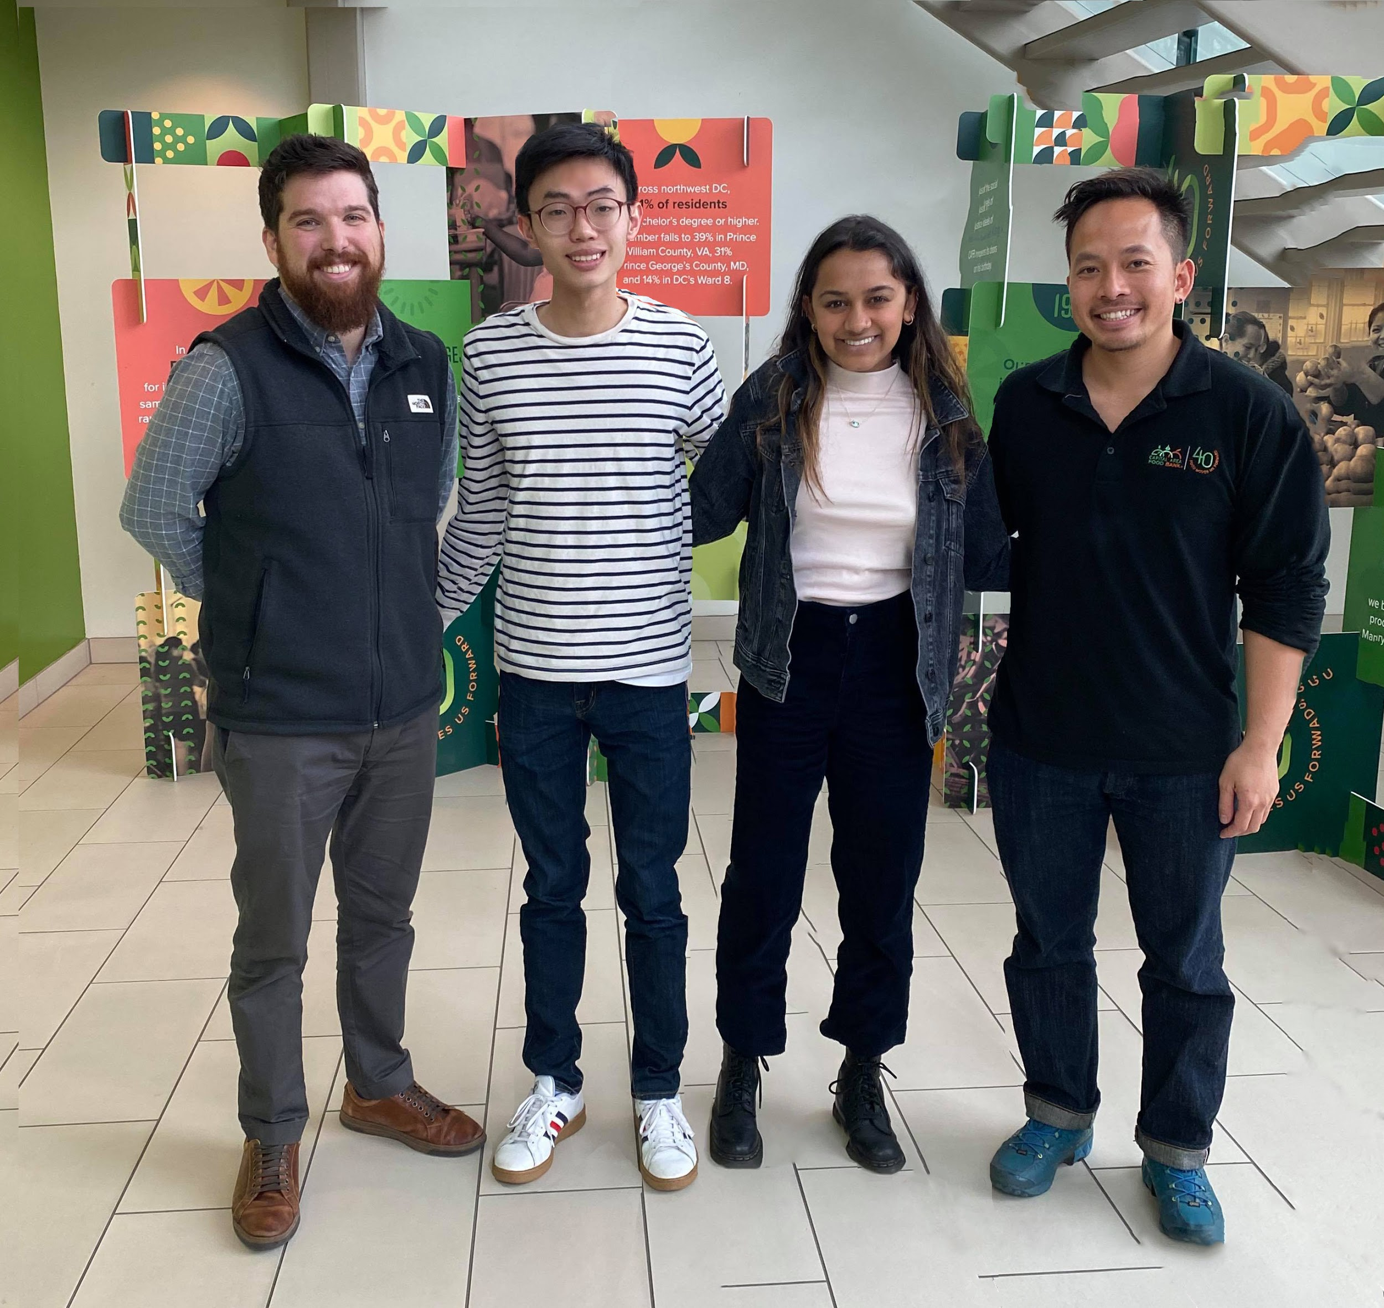

Thank You!
Special thanks to:
Dr. Joseph Bailey
Joshua Kohn
Jake Erlich
Tim Le
Notes:
CAFB logo colors:
Dark green: 529335
0D9F04
Light green: 97ba78
Orange: f7921e
Dark Blue3: 073763

